Slide 1


PFIZER (Pharmaceutical Sales Force Team)
Group 7
Sai Vamsi Bulusu
Harichandana Gonuguntla
Bryce Hatch
Neil Samuel Sadanand Pulukuri

Slide 2





Today’s Agenda
Pfizer Sales Team Overview
Database Features
Conceptual & Logical Models
Database Setup & Insights
Conclusion

Slide 3

Overview
Pfizer is a multinational pharmaceutical corporation that develops and produces a wide range of prescription drugs and vaccines for various medical conditions, including cancer, cardiovascular disease, and infectious diseases
A pharmaceutical company sales force team is responsible for promoting and selling the company's products to healthcare professionals
They may also organize educational events or conferences to increase awareness about their products
They must be able to build and maintain relationships with their customers to drive sales and meet their targets

Slide 4
Today’s Agenda
Pfizer Sales Team Overview
Database Features
Conceptual & Logical Models
Database Setup & Insights
Conclusion

Slide 5
Features of the model database
A system to manage customer interactions and track sales activities should be available.
A process to track compliance with regulatory requirements for sales activities should be made available.
The database should have robust reporting and analytics features to help sales managers track key performance metrics and identify areas for improvement. Reports should be customizable and easy to generate, with the ability to drill down to specific data points.
The database should maintain detailed sales data, including transaction dates, amounts, products sold, and sales representative's details. This information can be used to analyze sales trends, identify high performing sales representatives, and measure sales performance.

Slide 6
Features – Key entities
Entity | Description
Employee | information about each employee on the sales force team
Territory | information about each sales territory that the team/ representative covers
Account | information about each account/ customer that the team/ representative is responsible for
Product | information about each product that the company sells
Order | information about each order that the team processes
Invoice | information about each invoice that is generated
Call | information about each call that an employee makes to a account/ customer
Visit | information about each in-person visit that an employee makes to a account/ customer
Sample | information about each sample that is given to a account/ customer
Expense | information about each expense that an employee/ representative incurs
Goal | information about each sales goal that an employee is assigned
Achievement | information about each sales achievement that an employee makes

Slide 7
Today’s Agenda
Pfizer Sales Team Overview
Database Features
Conceptual & Logical Models
Database Setup & Insights
Conclusion

Slide 8
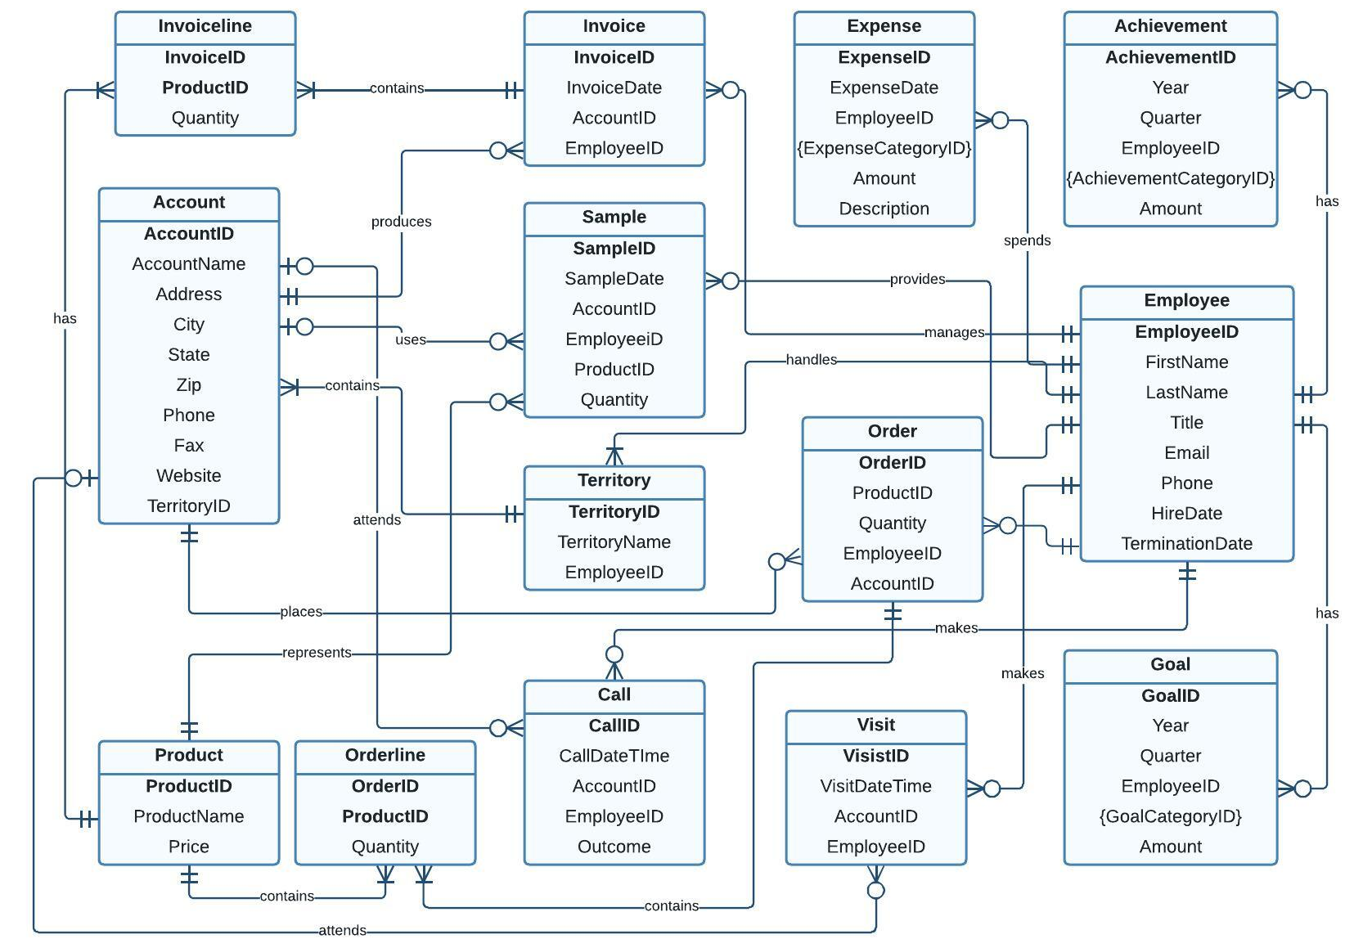
Conceptual Model

Slide 9
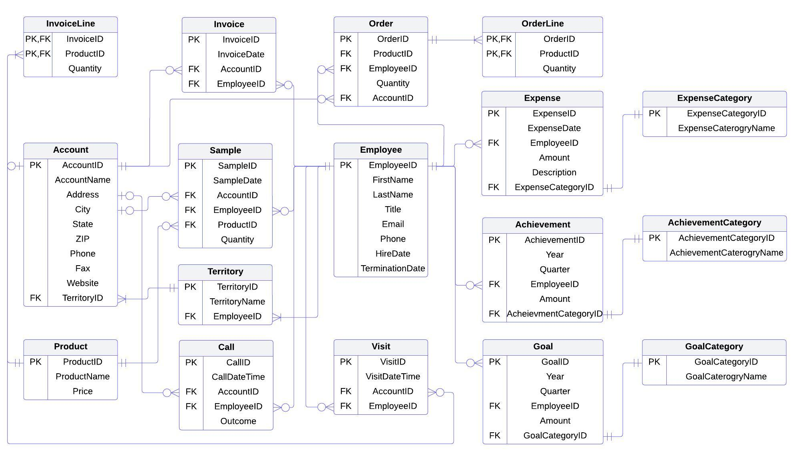
Logical Model

Slide 10
Today’s Agenda
Pfizer Sales Team Overview
Database Features
Conceptual & Logical Models
Database Setup & Insights
Conclusion

Slide 11
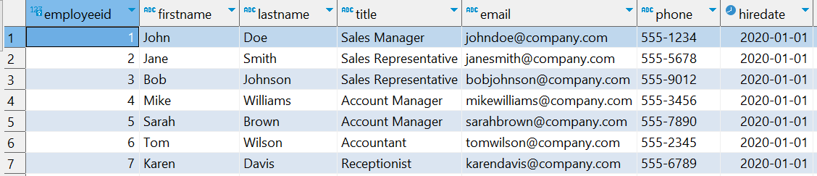
Creating Employee table & inserting data
CREATE TABLE Employee
(
EmployeeID INT PRIMARY KEY,
FirstName VARCHAR(50) NOT NULL,
LastName VARCHAR(50) NOT NULL,
Title VARCHAR(50),
Email VARCHAR(100) UNIQUE,
Phone VARCHAR(20),
HireDate DATE NOT NULL,
TerminationDate DATE,
CONSTRAINT Employee_EmployeeID_uindex UNIQUE (EmployeeID)
);

Slide 12
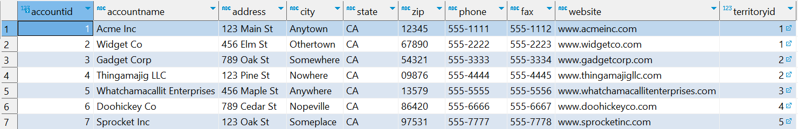
Creating Account table & inserting data
CREATE TABLE Account (
AccountID INT PRIMARY KEY,
AccountName VARCHAR(100) NOT NULL,
Address VARCHAR(200),
City VARCHAR(50),
State VARCHAR(50),
Zip VARCHAR(20),
Phone VARCHAR(20),
Fax VARCHAR(20),
Website VARCHAR(100),
TerritoryID INT NOT NULL,
CONSTRAINT Account_AccountID_uindex UNIQUE (AccountID),
CONSTRAINT Account_TerritoryID_fk FOREIGN KEY (TerritoryID) REFERENCES Territory (TerritoryID) ON DELETE CASCADE
);

Slide 13
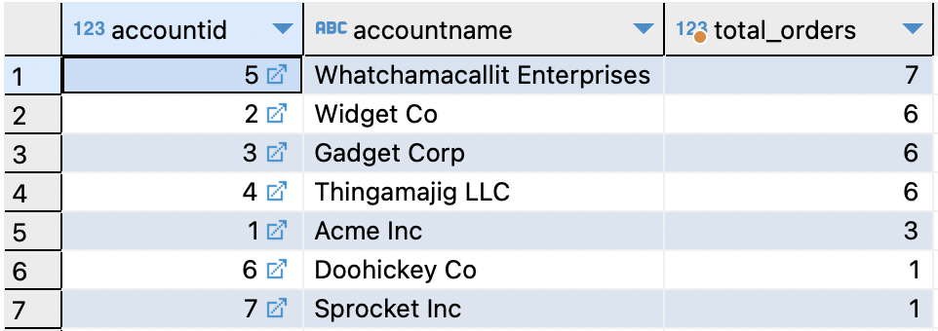
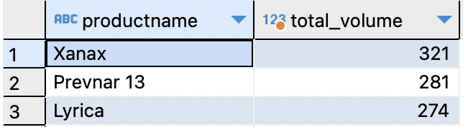
Data Insights
Total number of orders placed by each account
SELECT o.accountid, a.accountname, COUNT(orderid) as total_orders
FROM "Order" o
inner join account a
on o.accountid = a.accountid
GROUP BY o.accountid, a.accountname
ORDER BY total_orders DESC;
Top 3 best selling products
SELECT p.productname, sum(quantity) as total_volume
FROM product p
INNER JOIN orderline o ON o.productid = p.productid
GROUP BY p.productname
ORDER BY total_volume desc
limit 3;

Slide 14
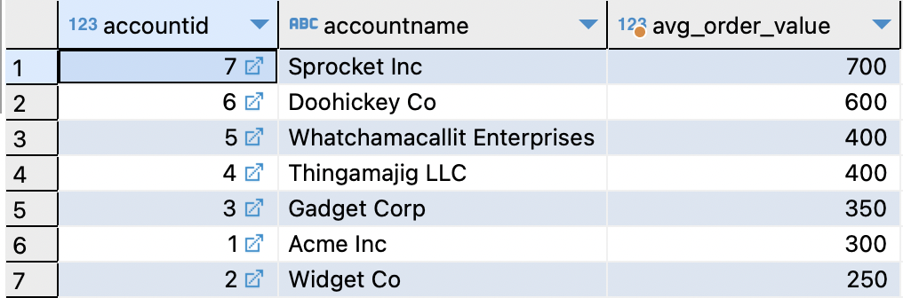
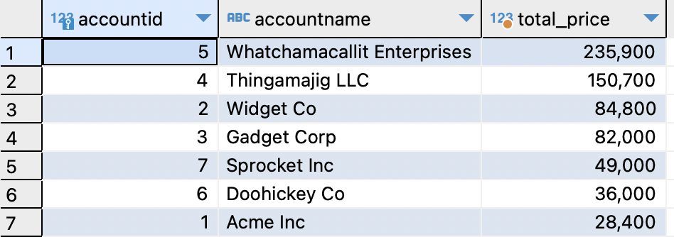
Data Insights
Average order value by each account
SELECT o2.accountid, a.accountname, round(AVG(price),2) as avg_order_value
FROM orderline o
inner join product p on o.productid = p.productid
inner join "Order" o2 on o2.orderid = o.orderid
inner join account a on a.accountid = o2.accountid
GROUP BY o2.accountid, a.accountname
ORDER BY avg_order_value DESC;
Accounts with highest lifetime value
select accountid , accountname, sum(total_price) as total_price from
(
SELECT a.accountid , a.accountname, o2.quantity, p.price, o2.quantity * p.price as total_price
FROM "Order" o
Inner join account a on o.accountid = a.accountid
inner join orderline o2 on o2.orderid = o.orderid
inner join product p on p.productid = o2.productid
) as D
GROUP BY d.accountid, d.accountname
order by total_price desc;

Slide 15
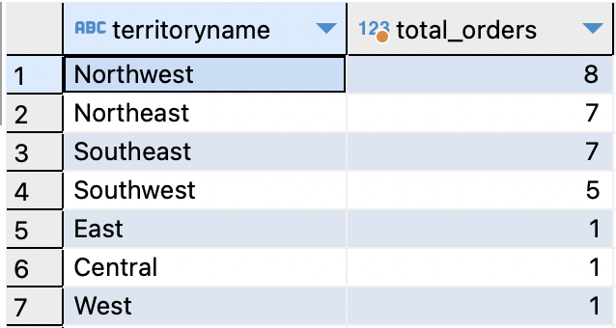
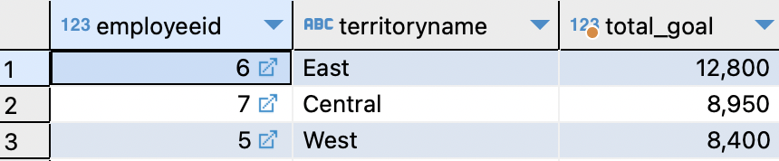
Data Insights
Top territories based on total orders
SELECT t.territoryname , count(o.orderid) AS total_orders
FROM territory t
INNER JOIN "Order" o
ON t.managerid = o.employeeid
GROUP BY t.territoryname
ORDER BY total_orders DESC;
Top 3 Employee with max goals in 2023 (all combined)
select employeeid, territoryname, sum(amount) as total_goal
from goal g
inner join territory t
on g.employeeid = t.managerid
group by employeeid , territoryname
order by total_goal desc
limit 3;

Slide 16
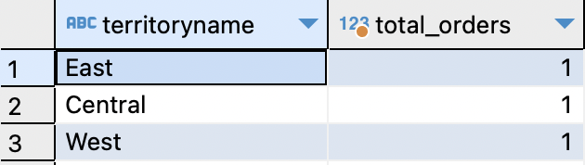
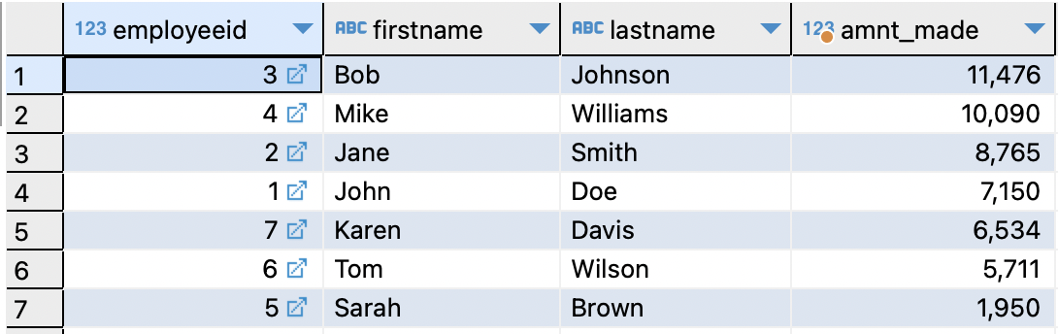
Data Insights
Bottom 3 territories
SELECT t.territoryname , count(o.orderid) AS total_orders
FROM territory t
INNER JOIN "Order" o
ON t.managerid = o.employeeid
GROUP BY t.territoryname
ORDER BY total_orders ASC
LIMIT 3;
Top employees based on total amount made (Achievement-Expense)
SELECT DISTINCT e.employeeid, e2.firstname, e2.lastname, (sum(ach.amount) - sum(e.amount)) AS amnt_made
FROM achievement ach
INNER JOIN expense e
ON ach.employeeid = e.employeeid
INNER JOIN employee e2
ON e2.employeeid = e.employeeid
GROUP BY e.employeeid, e2.firstname , e2.lastname
ORDER BY amnt_made DESC ;

Slide 17
Today’s Agenda
Pfizer Sales Team Overview
Database Features
Conceptual & Logical Models
Database Setup & Insights
Conclusion

Slide 18

Requirements Review
The purpose of our database is to pull information from our tables and receive a table that describes the salesperson's achievements, goals, and other important sales information.
You can see sales by territory/ account/ representative
Products can be added or removed
Employees can see goals/achievements
Goals, Achievements, and expenses are categorized
Samples, Orders, and invoices all can be traced with a date

Slide 19
Future Ideas
We could apply Artificial Intelligence (AI) drive data to our database and get lots of valuable information about the sales team that could lead to money saving ideas
Future:
AI and data-driven transformation will reconfigure the pharma value chain and pharma will go toward platform ecosystems
Now:
You can track sales, and personalized medicine
Near Future:
We are seeing innovation AI and data-driven transformation will play a bigger role in business innovation

Slide 20
Any Questions?

